Slide 1
SWAN Acoustic Test chamber
ALT Lonnie Kim, SH Son
First Update
2020.11.04
Last Update
2020.00.00

Slide 2
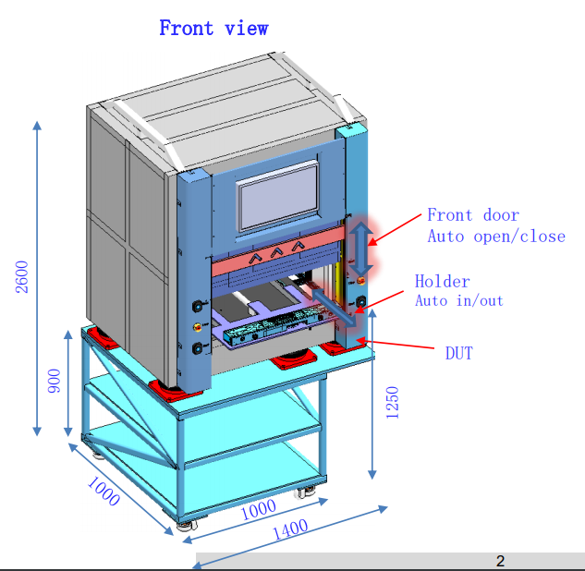
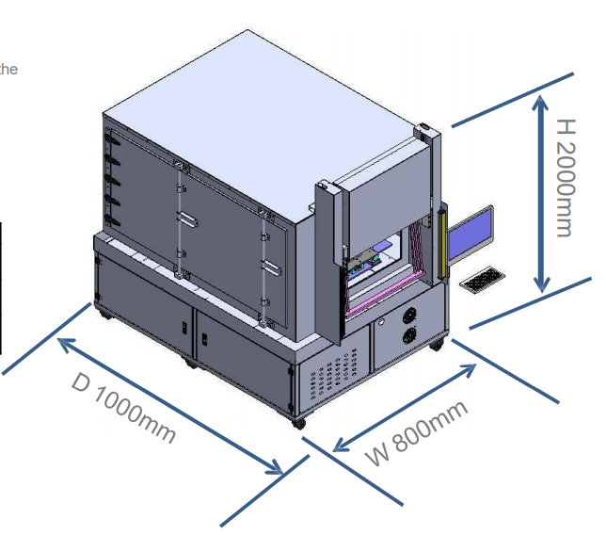
Out diameter
AI Soundbar Test Proposal (V04).pdf 9/16
AI Soundbar Test chamber Proposal v03(1).pdf 11/03

Slide 3
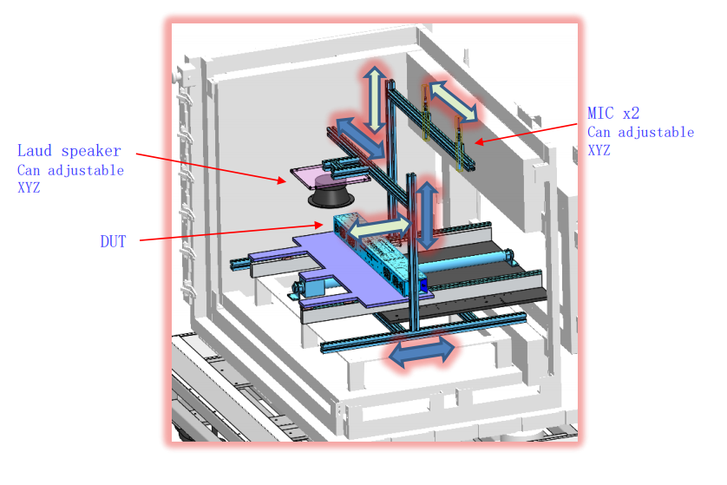
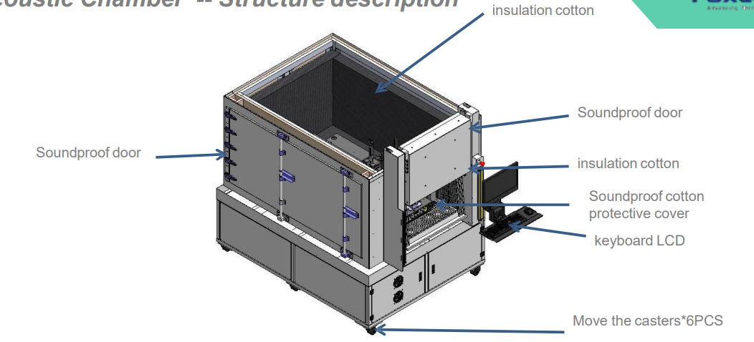
Inner structure
AI Soundbar Test Proposal (V04).pdf 9/16
AI Soundbar Test chamber Proposal v03(1).pdf 11/03

Slide 4
Question
Q1. Please explain the reason why the external structure is different from the previous proposal.
Q2. Why was the substructure changed?
Q2.1 Currently, the proposed substructure cannot be confirmed. It is unstable
Q2. It was a total solution that included test equipment (ig. PC), where did these installed?

